Slide 1

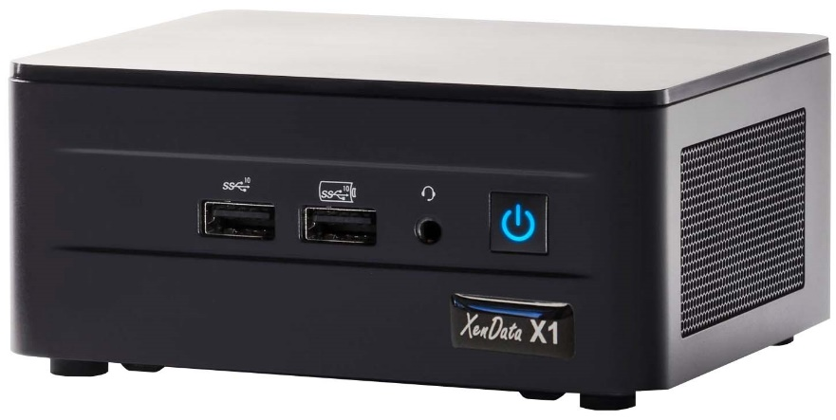
X1 Gen 2 for LTO
Storage Appliance

Slide 2
X1 for LTO
What does it do?
Archive | Backup | Share
Archives to LTO - manages unlimited LTO cartridges
Backup to cloud – accessible for DR
Share files in cloud – access worldwide

Slide 3
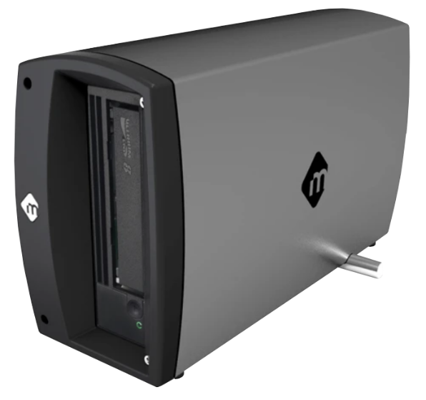
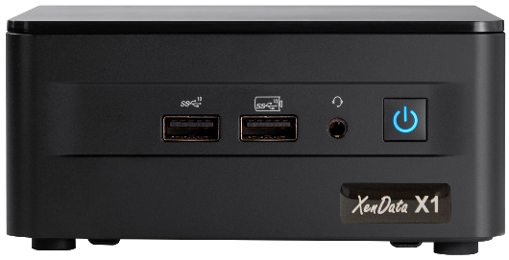
X1 for LTO
Manages one or more attached external LTO drives
X1 Appliance
Thunderbolt or USB
Network
External LTO Drive

Slide 4
X1 for LTO
Auto replicate with two or more drives
X1 Appliance
Network

Slide 5

X1 for LTO
AWS S3 | Azure | Wasabi S3
Auto replicates to the cloud
X1 Appliance
Network
External LTO Drive

Slide 6
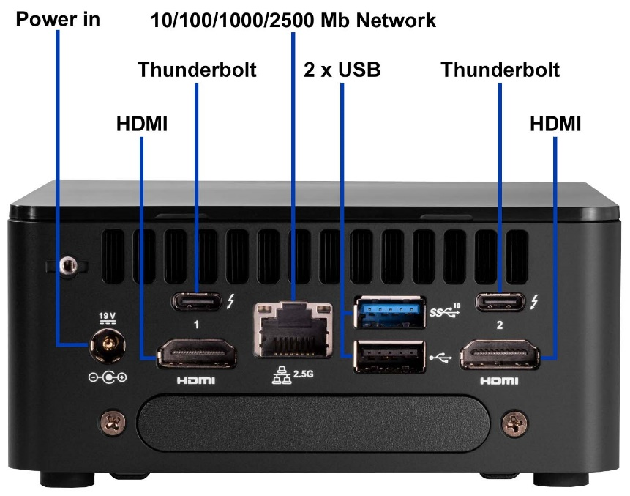
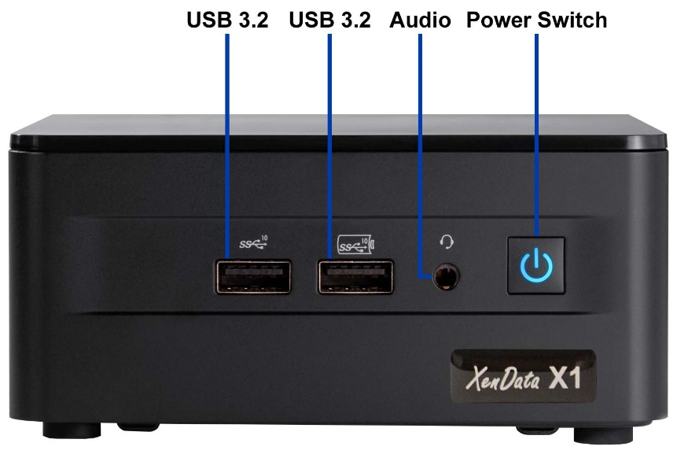
X1 Close Up
Front
Rear

Slide 7
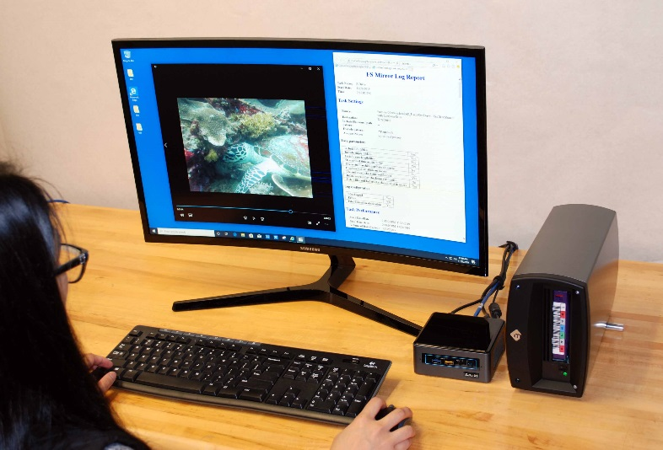
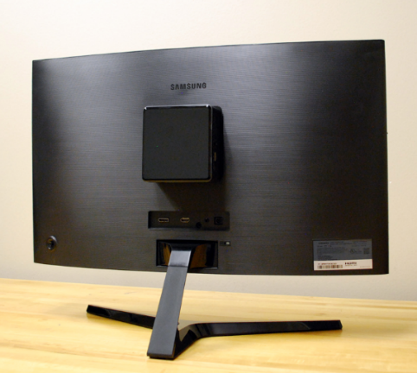
X1 Mounting
Free Standing
Versa Mount

Slide 8
Ways to Write to an X1
X1 Appliance
1. Write directly to an X1 Network Share
Great for archiving to LTO and/or cloud
2. Sync any Network Share to the X1
Mirror provides backup copy
Network

Slide 9
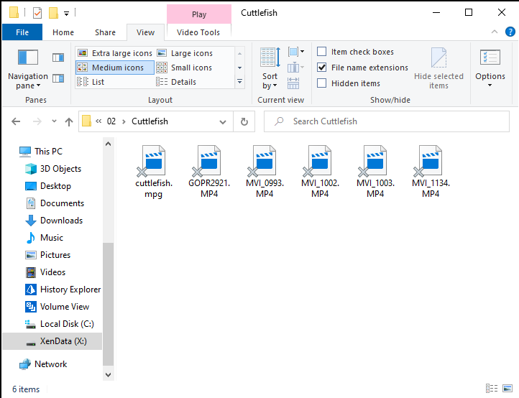
Write directly to an X1 Share
LTO Archive
Access via network or locally
Manages unlimited number if offline LTO cartridges

Slide 10
Sync Any Share to the X1
Backup & DR
Create mirror copies of any accessible file system on LTO and/or cloud. Cloud copies are available worldwide.

