Slide 1
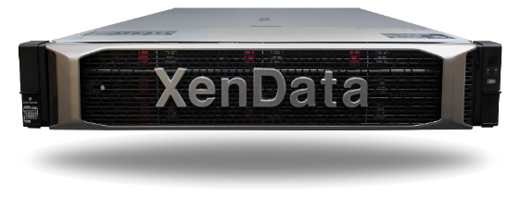
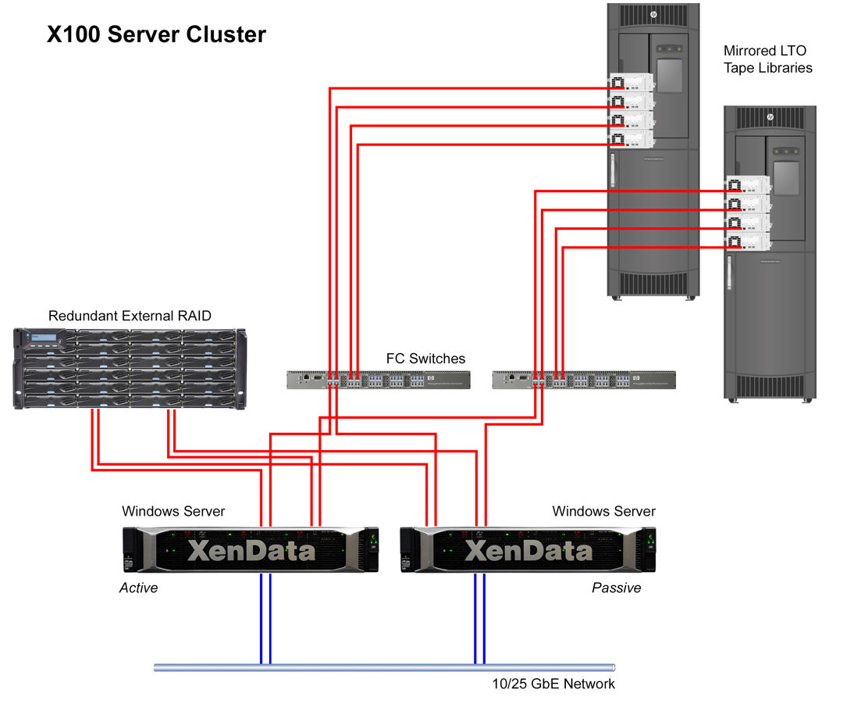
XenData LTO Active Archives
October 2022

Slide 2
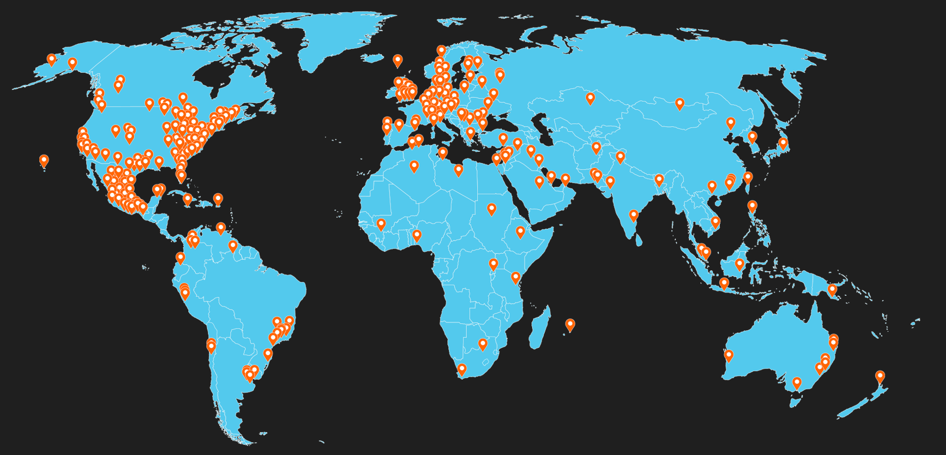
XenData – Proven LTO Archive Solutions Over 1500 systems with LTO libraries sold worldwide

Slide 3
Hundreds of proven Media & Advertising integrations
petabytes
Marquis Project Parking
FastTracker
MAM
N
Navigator X
… and many more

Slide 4
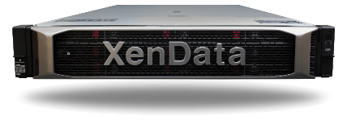
LTO Archive Appliances
X20-S A very cost-effective appliance for managing LTO libraries with 1 or 2 LTO drives
X40-S A highly redundant appliance for managing LTO libraries with up 4 LTO drives and multi-petabyte capacities
X60-S A highly redundant appliance for managing LTO libraries with up 10 LTO drives and multi-petabyte capacities

Slide 5
X100 Single Server or Cluster Scales to 100+ PB
Available as high-performance single server or as a cluster

Slide 6
Certified for use
with most LTO libraries
Support for Most LTO Libraries
Including from:
Dell | HPE | IBM | Oracle | Overland Quantum | Qualstar | Spectra Logic

Slide 7
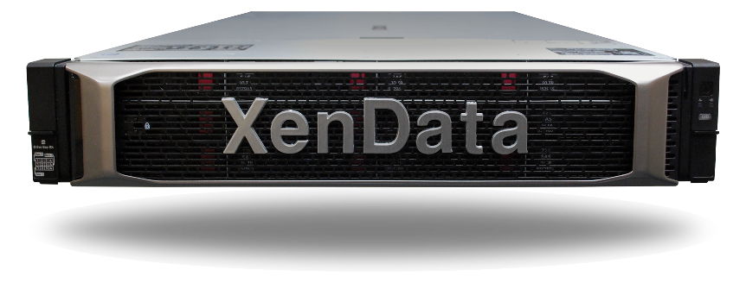
Functionality

Slide 8
Standards, Standards, Standards, Standards
Standard File System Interface Accepts all file types and presents them in a single Windows file/folder structure. Files are written to and retrieved as though from a standard disk drive.
Standard Network Protocols The solution is optimized for SMB and FTP, as well as local file transfers.
Standard S3 Interface Option Add an S3 interface to access your archive from anywhere. Your LTO archive becomes a private cloud.
LTFS and TAR May be configured with tape pools using the LTFS or TAR format.
Industry Standard File Security The appliance runs a Windows operating system and integrates fully with the Microsoft Windows security model based on Active Directory.

Slide 9
File System Interface
Archive Accessed Locally as a Logical Drive Letter Drive letter X: represents the entire contents of the archive including files on cache, on LTO in the library and on LTO cartridges that have been exported from the library.
Archive Mounts as Standard Share Archiving to and restoring from the archive share over a network is just like writing to and reading from a standard disk-based share.

Slide 10
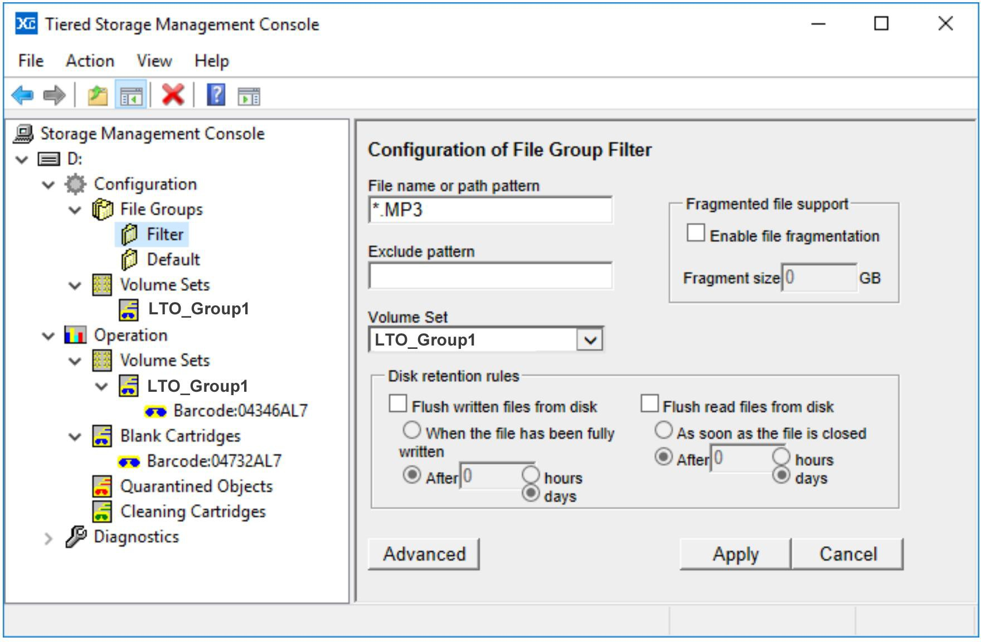
Disk Cache
Retains Frequently Accessed Files The disk retention rules may be tailored for specific folders and file types.
Immediate Archiving All files are initially written to disk which means there is no waiting for a cartridge to be automatically loaded in a drive.
Allows Prioritization for Restores Archive operations are automatically buffered on disk if needed to give priority to restores.

Slide 11
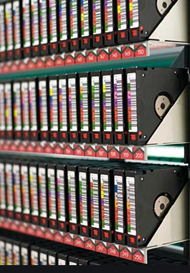
Offline Cartridge Management
Manages unlimited offline cartridges When a cartridge is exported from the library, its files remain in the file system. An attempt to restore an offline file, results in an on-screen message or email alert that identifies the cartridge that should be imported back into the library.

Slide 12
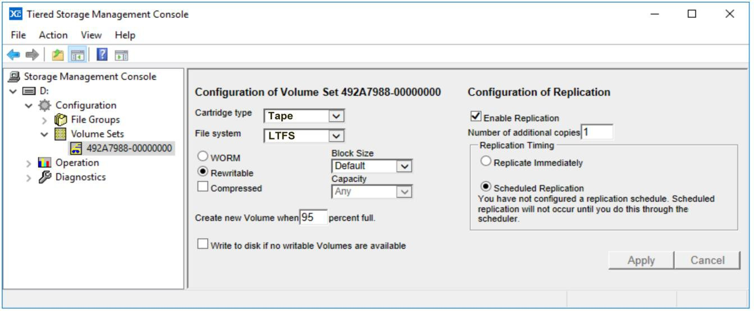
Cartridge Replication
Automatic Can be configured to replicate immediately or overnight.
Even works with one-drive libraries Just configure system to update the replica overnight. The day’s content is held on the disk cache.
Low-cost data protection An operator can export a replica from the library from time to time and keep offsite.

Slide 13
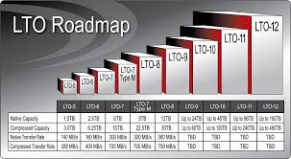
Easy Migration to Latest LTO Generation
Repack operation moves files from older generation of LTO to a later generation. Repack keeps files in same folder in file system and runs as a background task with zero downtime.
Repack may be scheduled to occur on off-hours
Transparent to applications The programs that are writing to and reading from the archive are not affected by the repack operation because all files have the same name and path.

Slide 14
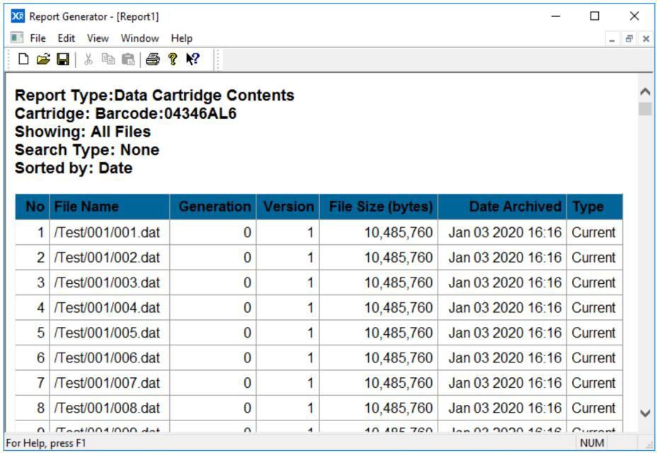
File Search and Cartridge Contents Reports
May be saved to Excel Allows for additional analysis

Slide 15
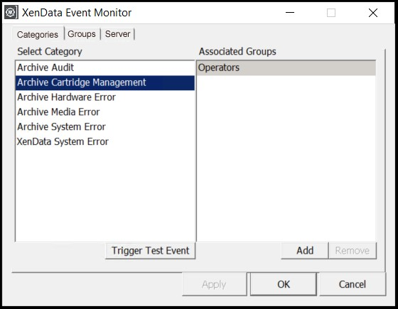
System Monitoring
Monitors error messages issued by the LTO drives and libraries. This is in addition to monitoring the appliance itself.
Provides email alerts These may be tailored to the needs of specific groups of recipients.

Slide 16
Upgrade Options

Slide 17
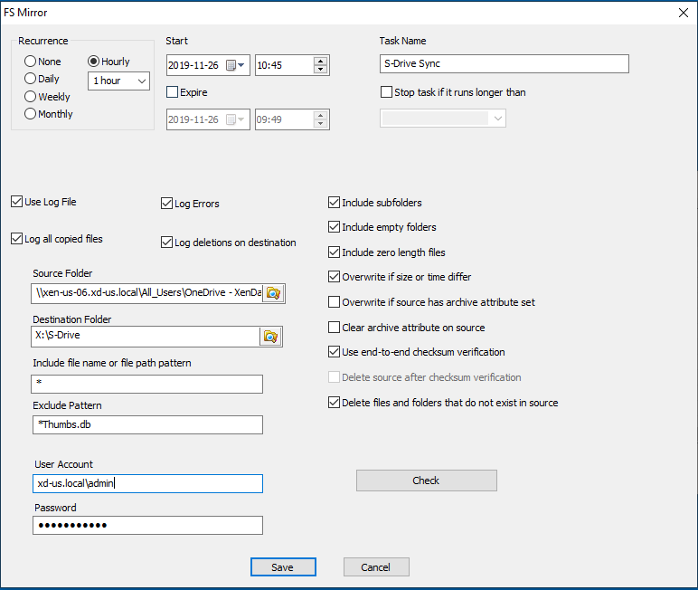
FS Mirror
FS Mirror, a XenData utility that provides file-folder synchronization and mirroring of any local or network storage, is an optional upgrade.
You can schedule tasks to sync any accessible file-folder structure to LTO.

Slide 18
Workflow API
Provides file moving capabilities and offline cartridge management.
Required for integration with several complementary applications, including:
Axle MAM
NLT Nearchive
Marquis Project Parking
Metus MAM
Sony NavigatorX
VSN
Vizrt

Slide 19
Public Cloud Interface
The appliance may be extended to manage cloud object storage in addition to an LTO library. The cloud connection is secure, using HTTPS, and fast, using multipart uploads and downloads. It is optimized for video files, supporting partial file restores and video streaming.
After installing and licensing the Cloud File Gateway Extension software, the tiered storage management policies support archiving to object storage or LTO.
Combine with FS Mirror and sync all content written to LTO to the cloud.

Slide 20
Private Cloud Interface
Access the LTO archive as Object Storage
By adding a XenData S3 Server interface and SSL certificate, the appliance may be accessed remotely via secure HTTPS.

Slide 21
For more information, please visit: www.xendata.com

